Slide 1

OPTIMIZATION OF PROCESS CONDITION BY USING THE DESIGN EXPERIMENT
BANNARI AMMAN INSTITUTE OF TECHNOLOGY SATHYAMANGALAM
(Autonomous Institution Affiliated to Anna University Chennai
Approved by AICTE - Accredited by NBA and NAAC with “A” Grade)
SUMMITED BY
SAKTHIUMA.K(172BT194)

Slide 2
OPTIMIZATION
Optimization is a technique used to develop a stable, high yielding and a product formation
It is used to optimize the cell density to produce a high quality and a safe product
Optimization plays a major role in determining a product formation

Slide 3
PARAMETER
Temperature
pH
Dissolved oxygen
Carbon and nitrogen source
Pressure
Macro and micro nutrient

Slide 4
TERMS USED IN OPTIMIZATION
FACTOR
It is an assigned variable such as concentration , Temperature etc
Quantitative- Numerical factor assigned to it eg 1%
Qualitative- Which are not numerical eg temperature, pH
LEVELS
Levels of a factor are the value assigned to the factor.
EFFECT
It is the change in response caused by varying the levels

Slide 5
TERMS USED IN OPTIMIZATION
RESPONSE
It is an outcome of the experiment.
INTERACTION
It gives the overall effect of two or more variables

Slide 6
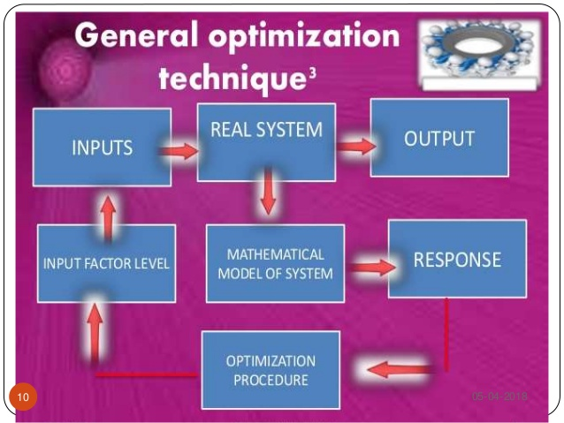

Slide 7
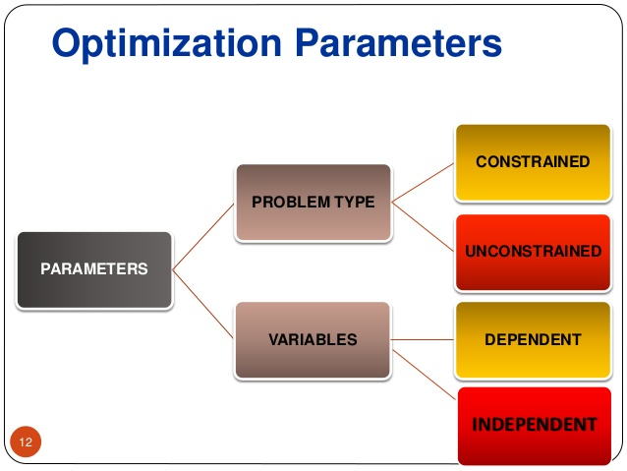
OPTIMIZATION PARAMETER

Slide 8
PROBLEM TYPE
CONSTRAINED
In this type it involves solving the problem by minimizing or maximizing the real values that are available within the set
UNCONSTRAINED
In this type it involves solving the problem by minimizing or maximizing the real values that can be chosen with no restriction

Slide 9
VARIABLE TYPE
DEPENDENT
The depend variable are one which is based on real values eg. Particle size, surface
INDEPENDENT
Independent variable are nothing but the real value eg temperature and pressure

Slide 10
SOFTWARES USED IN OPTIMIZATION
Minitab
Matrex
Omega
Design Expert 7.1.3
SYSTAT Sigma Stat 3.11
CYTEL East 3. 1

Slide 11
EXPERIMENT
My experiment is the optimization of parameter to extract active pharmaceutical ingredient from peace lily plant.
The active pharmaceutical compound present in plant source have more phytochemical and polyphenolic compound.
The compound present in the plant source such as flavonoids, phenolics, tannins. They contain more antioxidant activity.

Slide 12
Major parameters involved in the optimization process like varying the temperature and time by keeping the concentration of the solvent as constant.
This experiment was carried out under four trails.
The yield of the biomolecule obtained is identified by the total weight of the sample at the end of the process.

Slide 13
MATERIALS AND METHODS
MATERIALS
Leaves of peace lily
Plant extract
Ethanol
Boiling tubes
INSTRUMENTATION
Magnetic stirrer

Slide 14
METHODS
The plant extract was prepared
1ml of extract 9ml of ethanol was added and four trial was performed
Amount of biomolecule estimated= total weight of the sample after drying

Slide 15
BIOMOLECULE ESTIMATION
The estimation was done using minitab
By varying temperature and time and the solvent as constant
The correlation coefficient obtained from the minitab software
The yield of biomolecule is depend on time
 | TEMP | TIME | YIELD (g)
TEMP | 1 | 0 | 0.619644
TIME | 0 | 1 | 0.784883
YIELD | 0.619644 | 0.784883 | 1

Slide 16
FACTORIAL DESIGN
Factorial experiment is an experiment whose design consist of two or more factor each with different values
It is applied in optimization techniques.
Factorial design depends on independent variables

Slide 17
PLACKETT BURMAN
It is a popular class of screening design.
These are useful for detecting large main effects
It is helpful in finding the factors of the design

Slide 18
RESPONSE SURFACE METHODOLOGY
It is a easy way to estimate a first degree polynomial
It is a relationship between several variable variable and one response variable
In this design the yield of particular compound was maximized to find the product

Slide 19
ADVANTAGE
Require few experiment to determine the optimum condition
It is used to trace and rectify the problem
It gives a best solution

Slide 20


